Slide 1


Safely Sail
CityU-EE Gifted Education Fund Programme: AIoT Coding, Engineering and Entrepreneurial Skills Education for Gifted Students
To improve watersports safety through early SOS and rescue
Team Members (Project 27)
33 (Clement) Tong Yuk Chun

Slide 2
Introduction
About your project idea
Short description about your project
e.g.: “A personal protective equipment (PPE) detection system for construction workers”

Slide 3
Background & Motivation
What is the background of your project?
What motivated you to start this project?
What problems would you like to solve?
Vision, Goals & Objectives
Other Important Facts

Slide 4
What is the target market?
4000
3000
2000
1000
0
You may use charts or graphs to illustrate the result from market research

Slide 5
What is the target market?
You may add a table to compare data
 | A | B | C
Yellow | 10 | 20 | 7
Blue | 30 | 15 | 10
Orange | 5 | 24 | 16

Slide 6
Are there existing solutions?
How the problem has been addressed by the current solution?
What technologies they use?

Slide 7
What is your solution?
Possible improvements on the current solution
What new technologies to bring about

Slide 8
What is your solution?
A
B
C
You may use graphics to visualise your idea

Slide 9
What is your solution?
4.3%
9.5%
9.5%
21.3%
31.9%
30.5%
41%
21.3%
21.3%
9.5%
You may use data to support your idea

Slide 10

What is your solution?
How does it work?
Elaborate the concepts, technologies applied, etc.

Slide 11
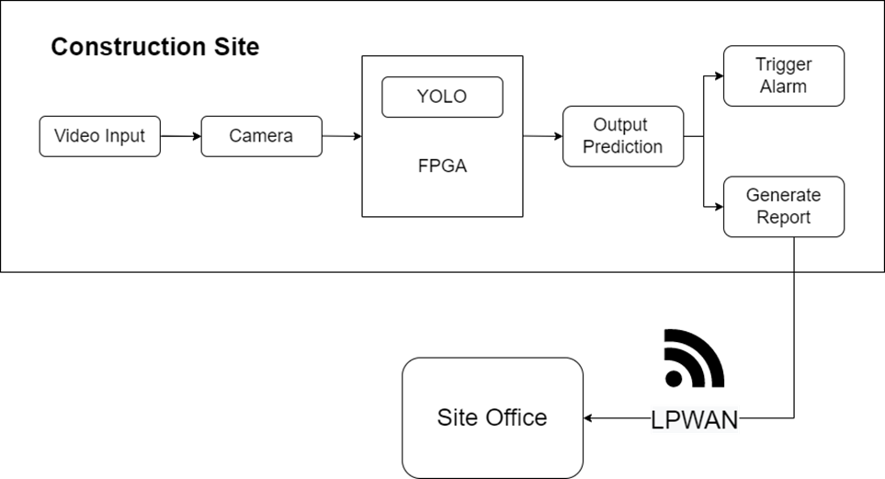
What is your solution?
You may insert a graph to illustrate the workflow of your solution, i.e.:

Slide 12
Timeline
Month/Date
Month/Date
Month/Date
Month/Date
Details of the task
Details of the task
Details of the task
Details of the task

Slide 13
Future work
Future plan to further develop the product
Plan to deploy and market the product

Slide 14
Thanks!
Any questions?
Contact details:
Email
Website, if any

